Slide 1
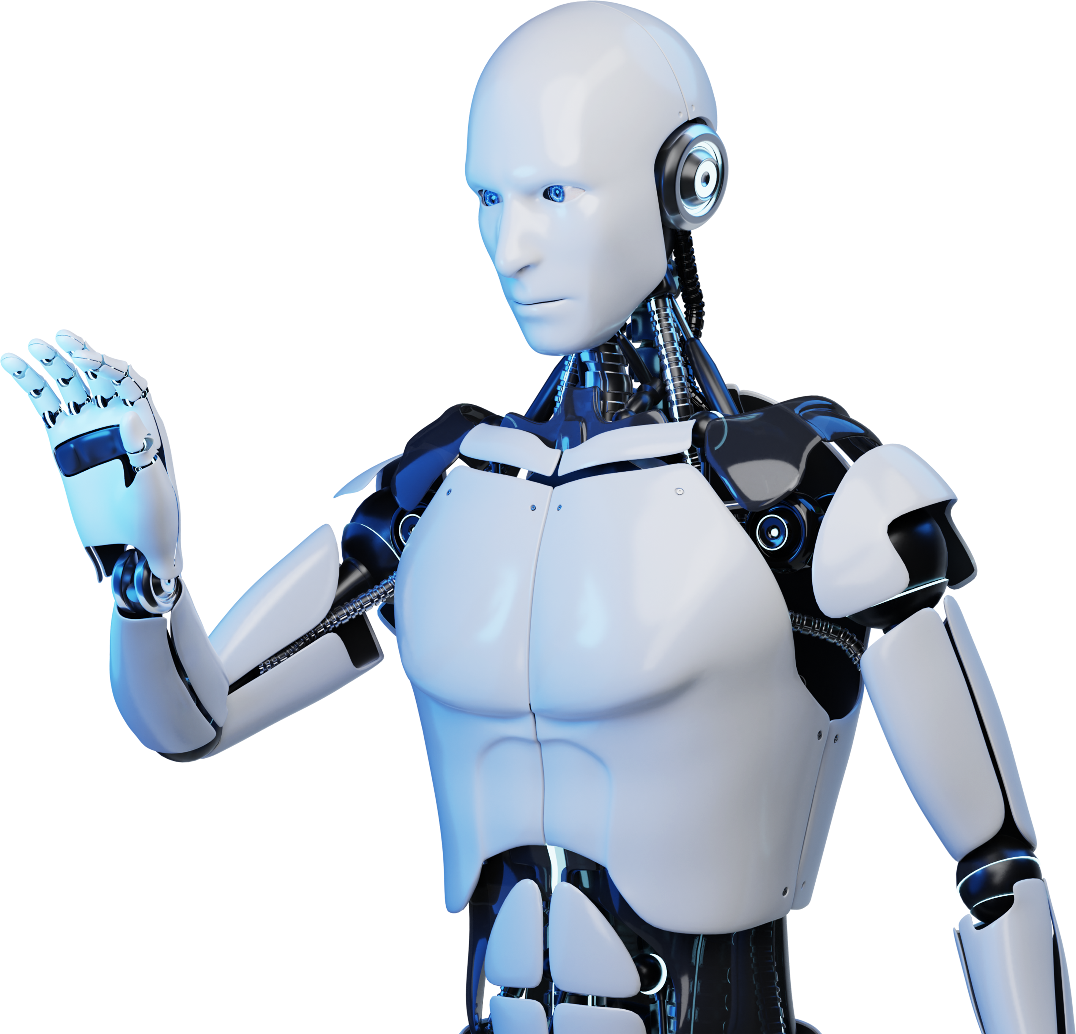
AI Chatbot Presentation
Presented By : Prince Rajak & Neha Daryani

Slide 2
Problem Statement:
In today’s fast-paced digital world, businesses and organizations struggle to provide instant, efficient, and personalized customer support. Traditional customer service methods, such as human-operated call centers and email support, are often slow, costly, and prone to errors. Additionally, handling large volumes of queries simultaneously becomes a challenge, leading to delays and customer dissatisfaction. The lack of 24/7 availability and inconsistent responses further contribute to inefficiencies in communication, affecting user experience and overall productivity.

Slide 3
Proposed Solution:
AI-powered chatbots offer an innovative solution to these challenges by providing instant, automated, and intelligent responses to user queries. Utilizing Natural Language Processing (NLP) and Machine Learning (ML), these chatbots can understand, process, and respond to messages in a human-like manner. They can handle multiple conversations simultaneously, offer 24/7 support, and reduce operational costs. By integrating AI chatbots into various industries, businesses can improve customer satisfaction, streamline workflows, and enhance efficiency.

Slide 4
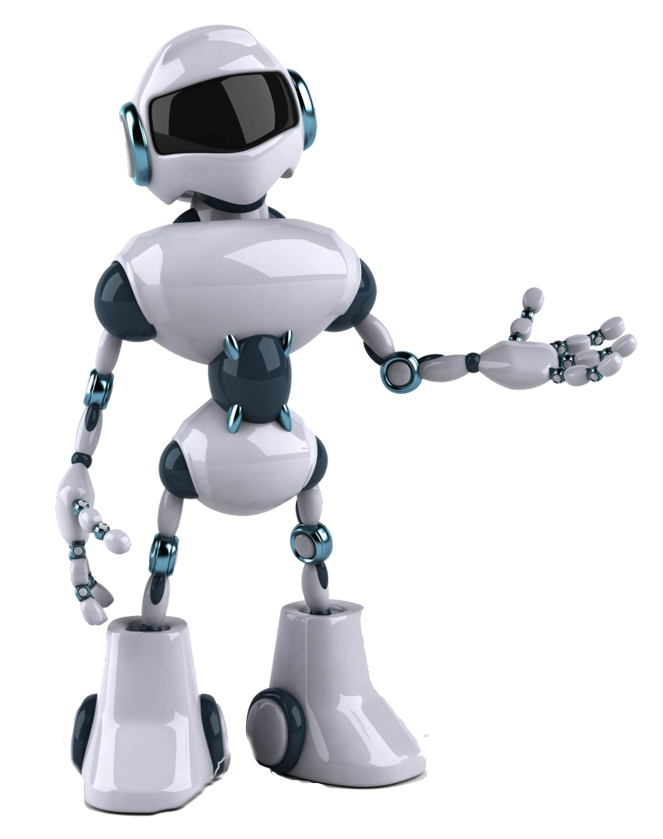
Introduction
AI Chatbots are computer programs that simulate human conversation, using artificial intelligence to interact with users and provide assistance.

Slide 5
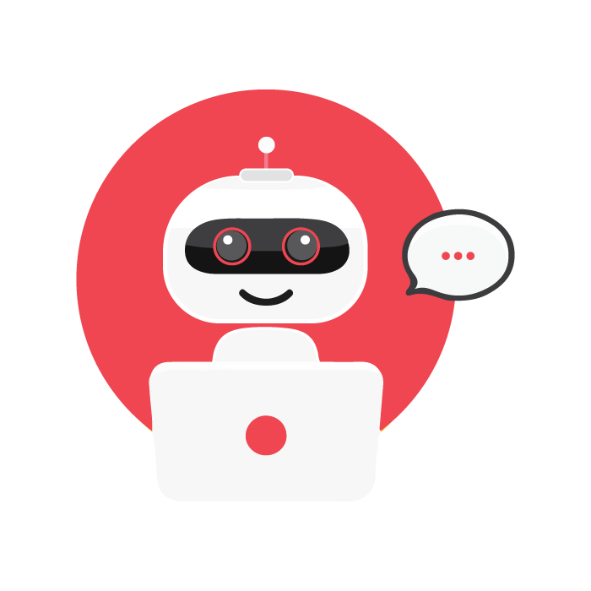
Technologies Used in AI Chatbots:
Natural Language Processing (NLP) NLP enables chatbots to understand, interpret, and generate human language. It involves techniques like tokenization, sentiment analysis, and entity recognition.
Machine Learning (ML) ML algorithms allow chatbots to learn from interactions, improve responses over time, and adapt to different user inputs.
Deep Learning Using neural networks, deep learning helps chatbots recognize speech patterns, understand complex queries, and enhance conversational abilities.
Speech Recognition Technologies like Automatic Speech Recognition (ASR) enable voice-based AI chatbots to process spoken language and convert it into text.
Text-to-Speech (TTS) and Speech-to-Text (STT) These technologies help chatbots communicate using voice.

Slide 6
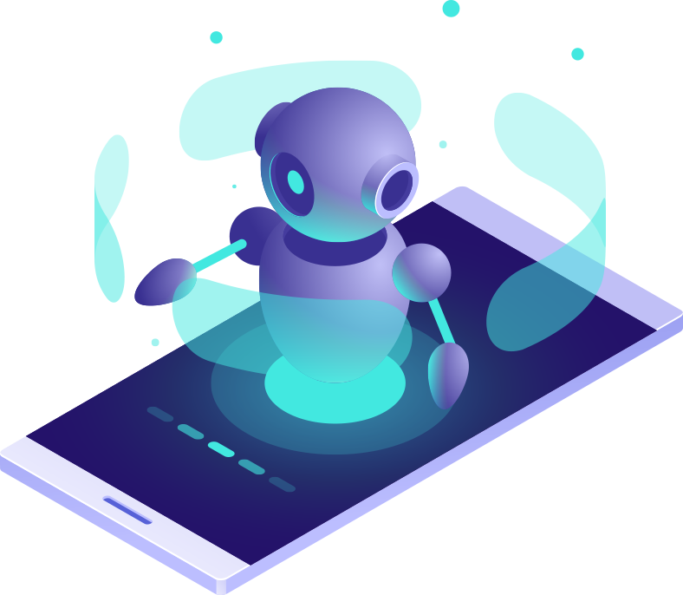
Feasibility of AI Chatbot:
Technical Feasibility: AI chatbots use NLP, ML, and cloud computing for efficient communication and automation.
Operational Feasibility: They enhance customer service by providing instant responses and reducing human workload.
Economic Feasibility: Chatbots lower operational costs with subscription or pay-per-use models, ensuring long-term savings.

Slide 7
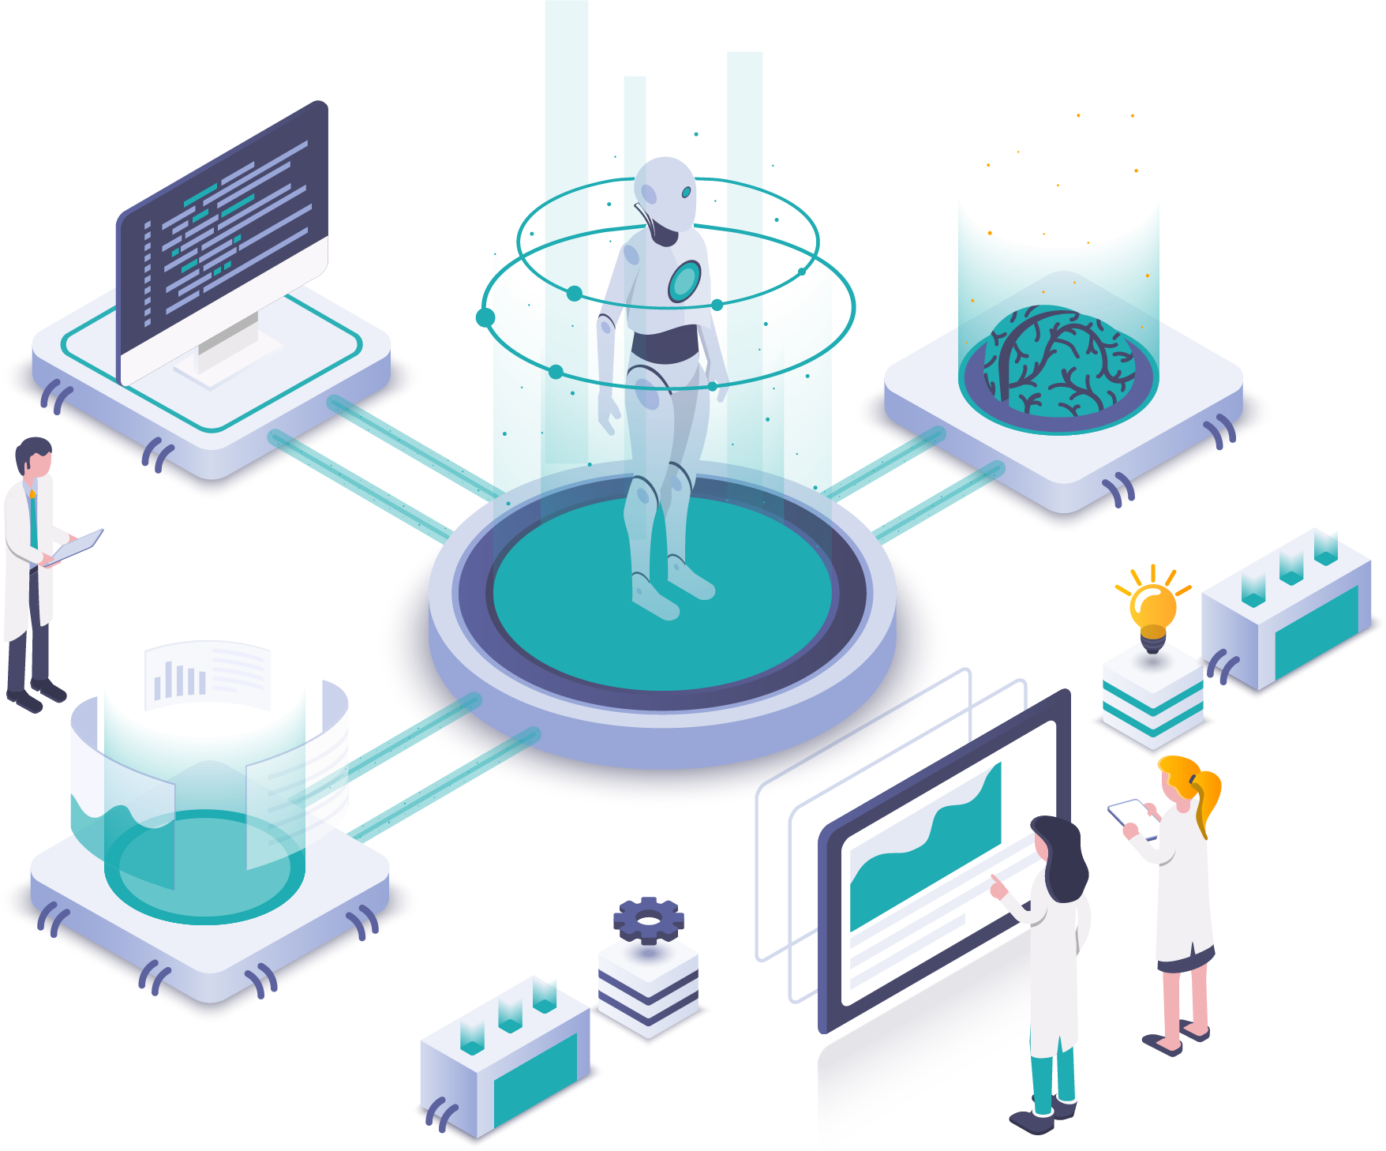
Role Of NLP
Natural Language Processing (NLP) enables AI Chatbots to understand and process human language, allowing for more effective communication.

Slide 8
Design Principles For Interactions
1
User-Centered Design
6
Accessibility and Inclusivity
2
Clarity and Simplicity
7
Learnability
3
Consistency
8
Flexibility and Control
4
Feedback and Responsiveness
9
Error Prevention and Recovery
5
Contextual Relevance
10
Delight and Emotional Engagement

Slide 9
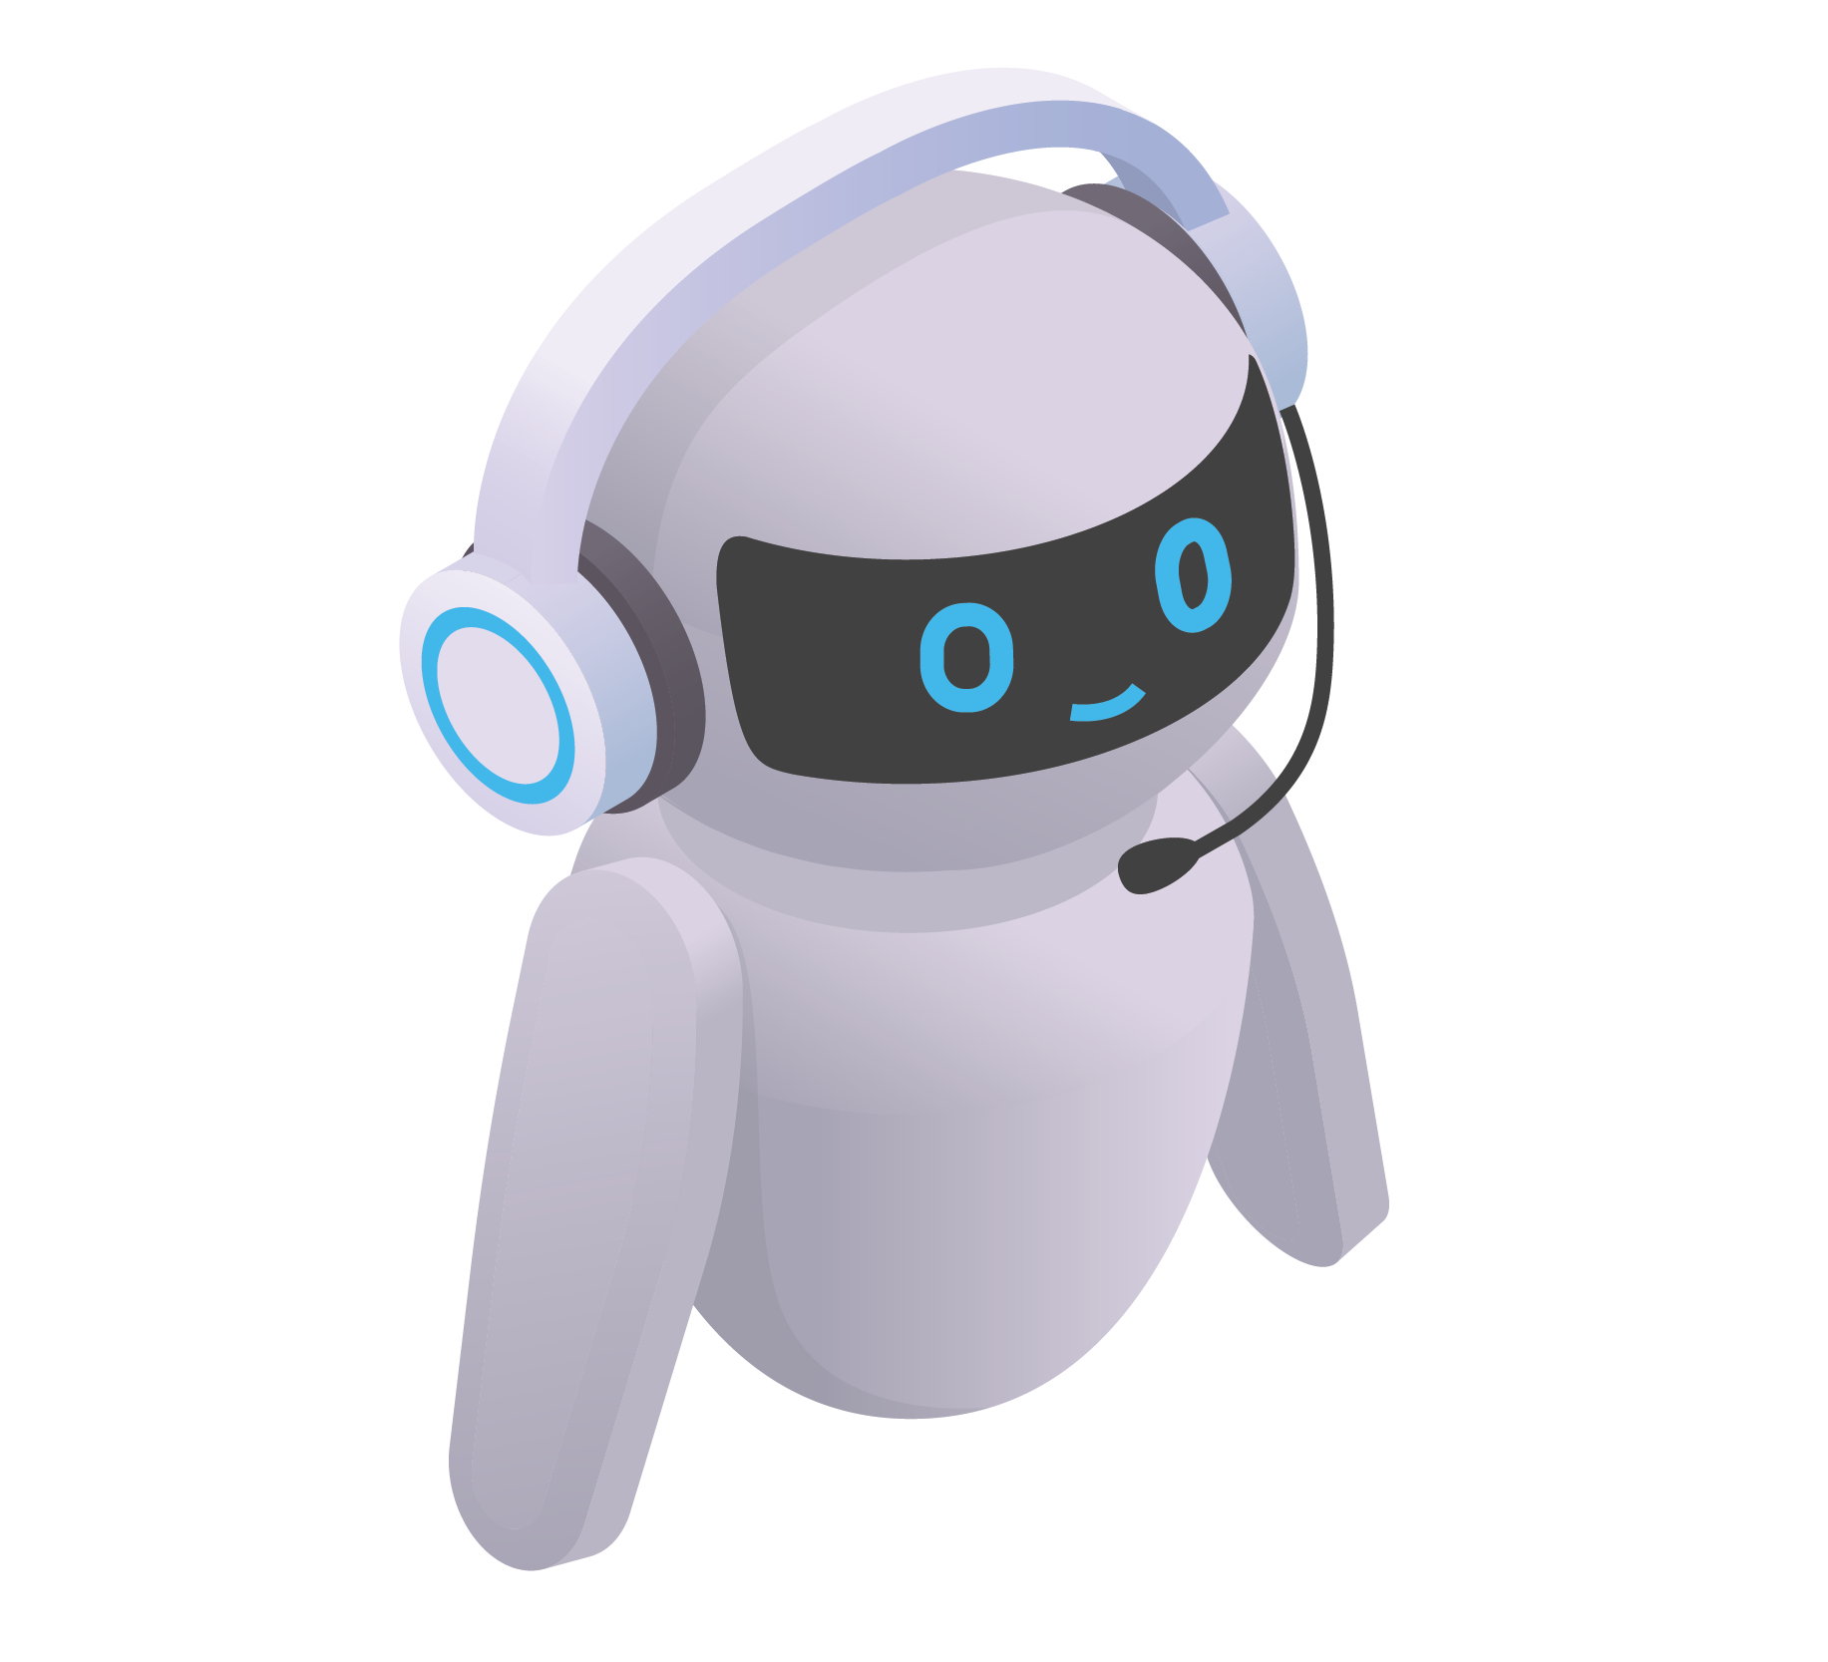
Impact and Benefits of AI Chatbots:
Improved Customer Support – AI chatbots provide 24/7 instant responses, reducing wait times and improving customer satisfaction.
Cost Savings – Businesses save on operational costs by automating repetitive tasks and reducing the need for large support teams.
Increased Efficiency – Chatbots handle multiple queries simultaneously, streamlining processes and enhancing productivity.

Slide 10
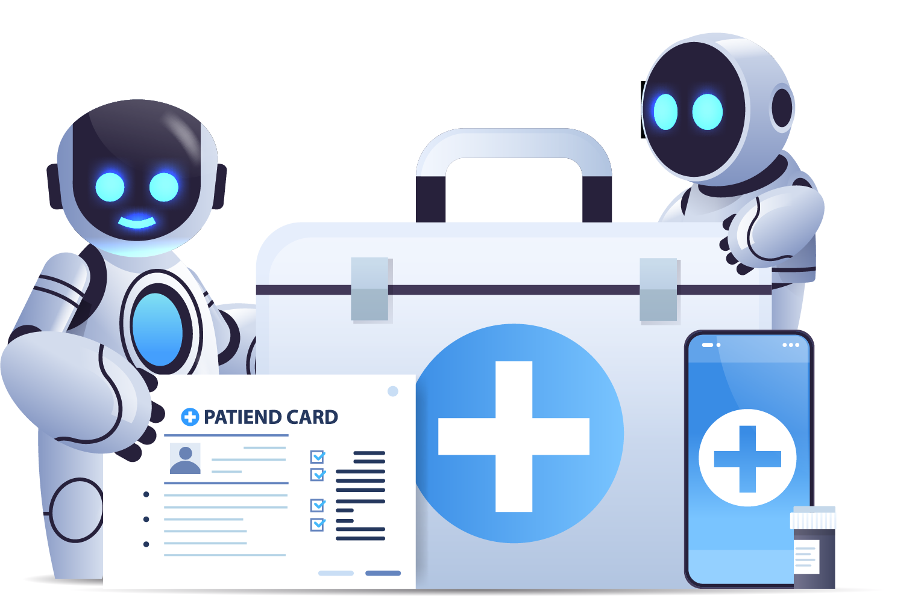
AI Chatbots In Healthcare
Symptom Assessment and Advice
AI Chatbots provide preliminary medical guidance based on symptoms.
Appointment Management
AI Chatbots assist in scheduling and reminding patients of healthcare appointments.
Health Monitoring and Education
AI Chatbots offer personalized health monitoring and educational resources.

Slide 11

AI Chatbots In E-commerce
AI Chatbots in e-commerce offer personalized product recommendations, assist in purchase decisions, and provide seamless customer support and assistance.

Slide 12
Natural Language Understanding
Lack of Contextual Understanding
Emotional Intelligence
Handling Complex Queries
Lack of Creativity and Empathy
Challenges and limitations
Data Privacy and Security
User Trust and Transparency
Maintenance and Updates

Slide 13
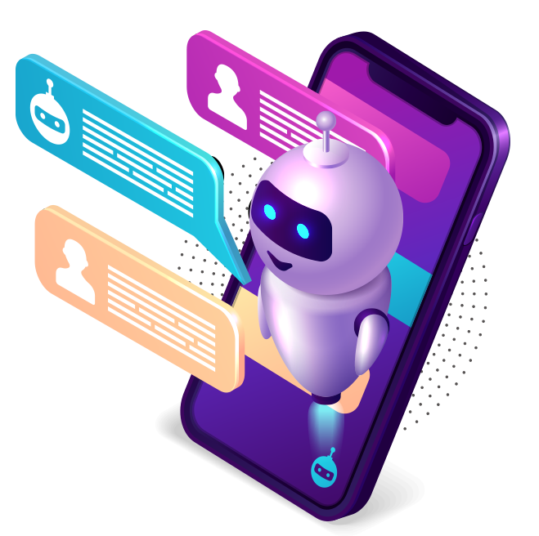
AI Chatbots In Virtual Assistants
AI Chatbots integrated into virtual assistants enhance their capabilities, enabling natural language interactions and seamless task automation.

Slide 14
AI Chatbots
For Knowledge Sharing
Instant Access
AI Chatbots provide immediate access to information, resources, and answers, enhancing knowledge sharing efficiency.
Personalized Assistance
AI Chatbots deliver tailored knowledge support, guiding users through information, learning materials, and relevant resources.

Slide 15
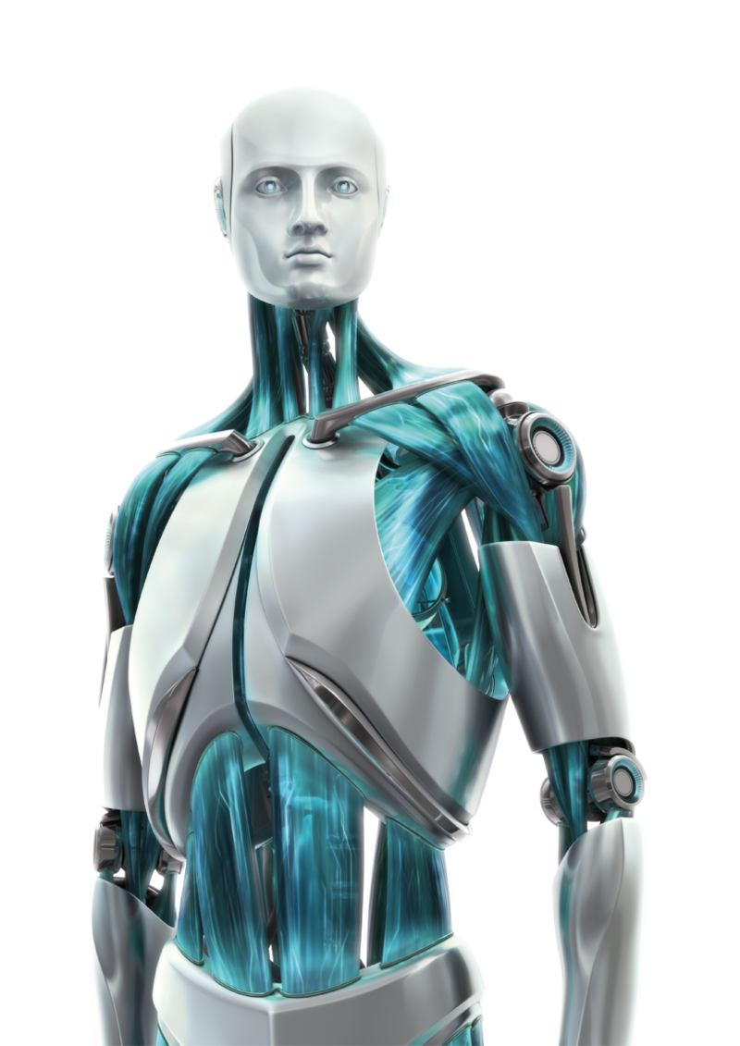
Human-AI Collaboration
Human-AI collaboration combines human expertise with AI Chatbots, enabling more efficient problem-solving, decision-making, and customer interactions.

Slide 16

AI Chatbots In Education
AI Chatbots in education facilitate personalized learning experiences, provide instant feedback, and support student engagement and progress tracking.

Slide 17
AI Chatbots For Social Media
AI chatbots have become increasingly popular for social media platforms as they offer businesses and users a range of benefits. Here are some ways AI chatbots are used on social media:
Customer Support
Interactive Content Delivery
Personalized Recommendations
Automated Posting and Scheduling
Lead Generation and Qualification
Influencer Marketing
Social Listening and Sentiment Analysis
Social Media Advertising

Slide 18
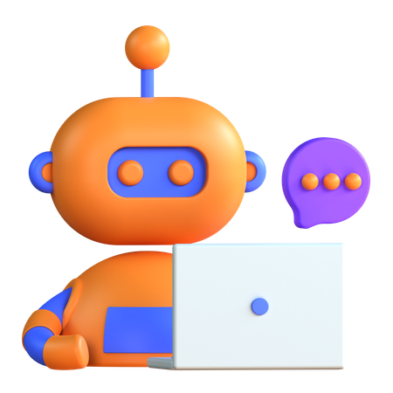
Future Trends In Technology
Future trends in technology include advancements in AI Chatbot capabilities, such as improved natural language understanding and contextual conversations.

Slide 19
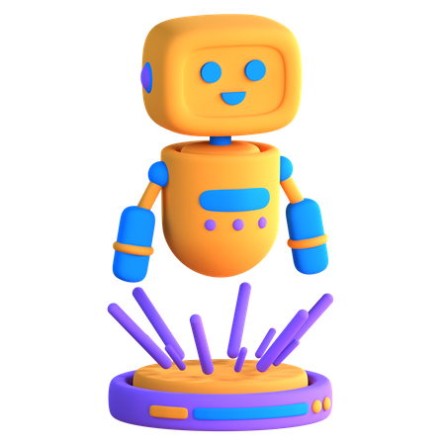
Conclusion
In conclusion, AI Chatbots revolutionize customer service, enhance user experiences, and drive operational efficiency, empowering businesses to thrive.

Slide 20
"AI is like a canvas, and human creativity is the paintbrush that brings it to life."

